Slide 1
Navigating PFAS in Drinking Water

Slide 2

Presenter
Sierra Kubicki
Rural Community Assistance Corporation
Assistant Field Manager, Arizona
725-278-2686
sierra.kubicki@rcac.org

Slide 3
What’s on the Agenda Today?
What is PFAS?
How did it get here?
Could it be in my well?
What does it mean for my health?
What can I actually do about it?

Slide 4
Key Takeaways
The purpose of this presentation is education and awareness.
PFAS is being found across the country, both in rural and urban areas.
Having PFAS in groundwater does NOT automatically mean immediate danger.
Private well owners are responsible for their own water testing, so understanding PFAS matters.
Public Water Systems are responsible for ensuring safe drinking water to their customers
  Safe Drinking Water Act

Slide 5
Where did PFAS come from and what are they?
PFAS = Per- and Polyflouroalkyl Substances
Manufactured chemicals that have been used in industry and consumer products since the 1940s.
Because of their widespread use and their persistence in the environment, many PFAS are found in the blood of people and animals all over the world. There are thousands of different PFAS, some of which have been more widely used and studied than others.

Slide 6
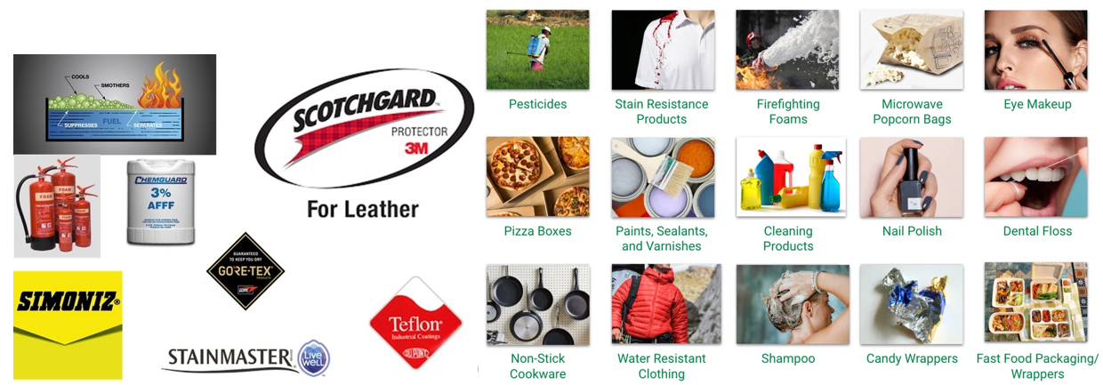
Where did PFAS come from?

Slide 7
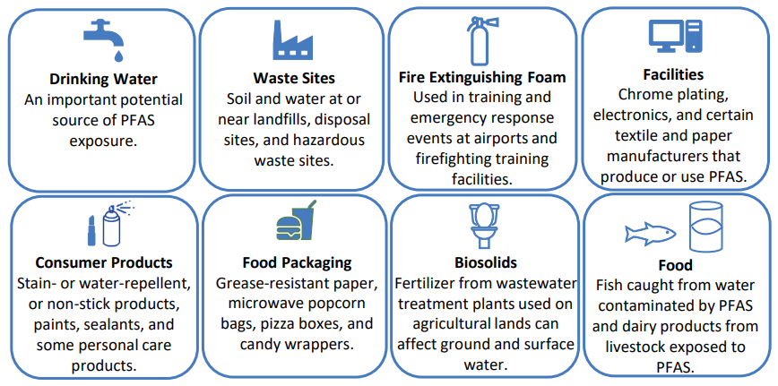
Main Sources of PFAS

Slide 8
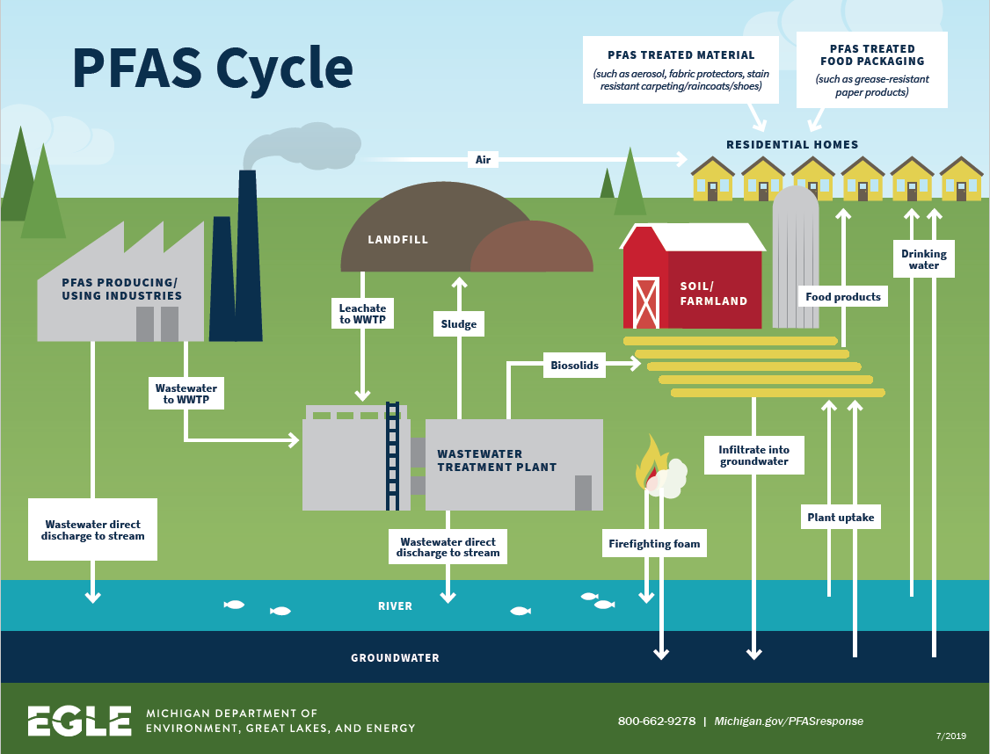

Slide 9

PFAS & Groundwater
Why PFAS stays in groundwater
strong chemical bonds,
slow natural breakdown,
groundwater moves slowly.

Slide 10
PFAS & Groundwater
Why private wells matter
no routine federal monitoring,
testing is voluntary,
homeowners manage treatment decisions.

Slide 11
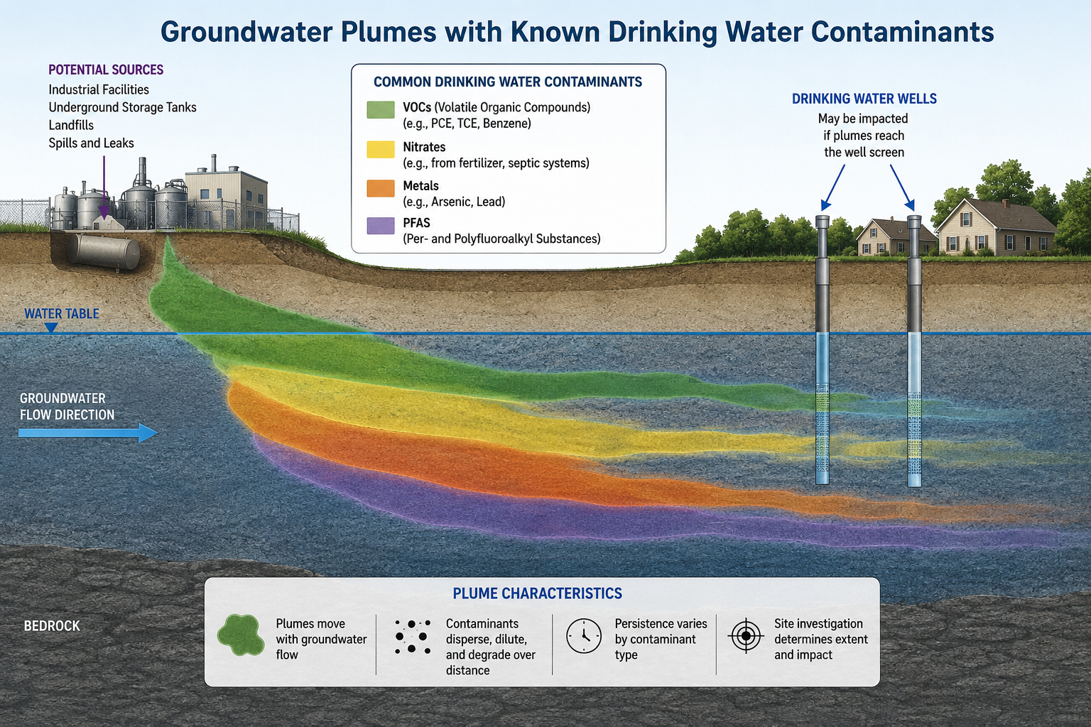
Groundwater Plumes

Slide 12
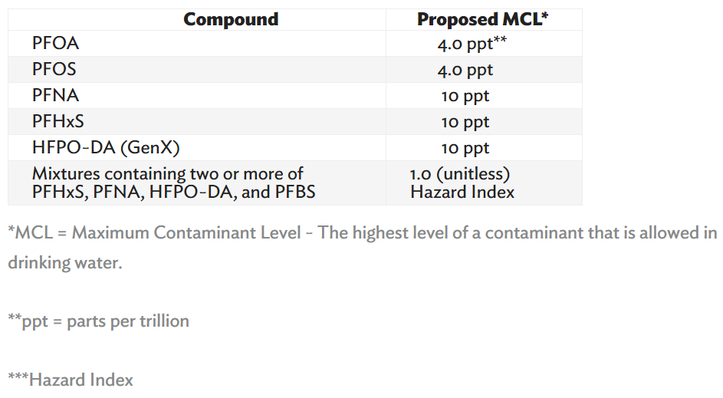
Final Rules & Regulations: MCL’s

Slide 13
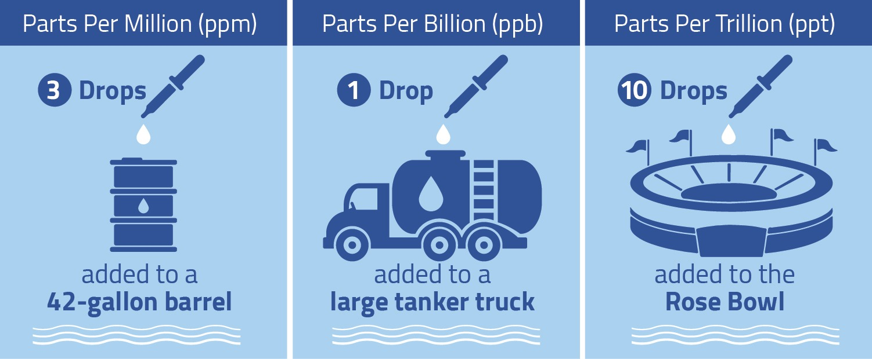
Final Rules & Regulations: MCL’s

Slide 14
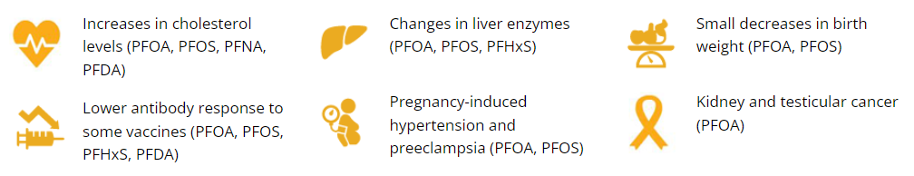
Health Effects of PFAS (CDC)

Slide 15
Health Effects of PFAS (EPA)
Current peer-reviewed scientific studies have shown that exposure to certain levels of PFAS may lead to:
Reproductive effects such as decreased fertility or increased high blood pressure in pregnant women.
Developmental effects or delays in children, including low birth weight, accelerated puberty, bone variations, or behavioral changes.
Increased risk of some cancers, including prostate, kidney, and testicular cancers.
Reduced ability of the body’s immune system to fight infections, including reduced vaccine response.
Interference with the body’s natural hormones.
Increased cholesterol levels and/or risk of obesity.

Slide 16
Health Effects of PFAS (EPA)
Adults
Some people have higher exposures to PFAS than others because of their occupations or where they live. For example:
  Industrial workers who are involved in making or processing PFAS or PFAS-containing materials, or people who live or recreate near PFAS-producing facilities, may have greater exposure to PFAS.
  Pregnant and lactating women tend to drink more water per pound of body weight than the average person and as a result they may have higher PFAS exposure compared to other people if it is present in their drinking water.

Slide 17
Health Effects of PFAS (EPA)
Children
Because children are still developing, they may be more sensitive to the harmful effects of chemicals such as PFAS. They can also be exposed more than adults because:
  Children drink more water, eat more food, and breathe more air per pound of body weight than adults, which can increase their exposure to PFAS.
  Young children crawl on floors and put things in their mouths which leads to a higher risk of exposure to PFAS in carpets, household dust, toys, and cleaning products.

Slide 18
Health Effects of PFAS: How do you address them?
The responsibility remains with the well owner (private or public).
If you have concerns about potential PFAS, research your area and ask your neighbors and local businesses if they have tested and seen PFAS in their sources.
Have your drinking water tested as soon as possible to be able to address any contamination or to ensure that their water being delivered by the utility is not a cause for concern.

Slide 19
Arizona Certified PFAS Testing Labs
Legend Technical Services of Arizona, Inc.
17631 North 25th Avenue Phoenix, AZ 85023
(602) 324-6103
azinfo@legend-group.com
City of Phoenix Water Services Laboratory
2474 South 22nd Avenue Phoenix, AZ 85009
(602) 534-9849

Slide 20
PFAS Testing
PFAS testing is specialized and more expensive than standard well testing.
Not every certified drinking water laboratory performs PFAS analysis.
Homeowners should specifically ask whether the lab analyzes PFAS using EPA Method 533 or EPA 537.1.
Some Arizona sample collection companies ship PFAS samples to out-of-state accredited laboratories for analysis.

Slide 21
Importance of Testing your Well for PFAS
Human Health
  Those with co-morbidities
  Pregnant women
  Children
Environmental Protection
  Source water protection
  Prevent further contamination
Animal & Agricultural Health
  Animals that ingest PFAS are affected
  Food that we consume

Slide 22
Mitigation: Methods
1. Treatment:
- Granular Activated Carbon (GAC)
- Ion Exchange (IEX)
- High Pressure Membranes
2. Consolidation
3. New Source

Slide 23
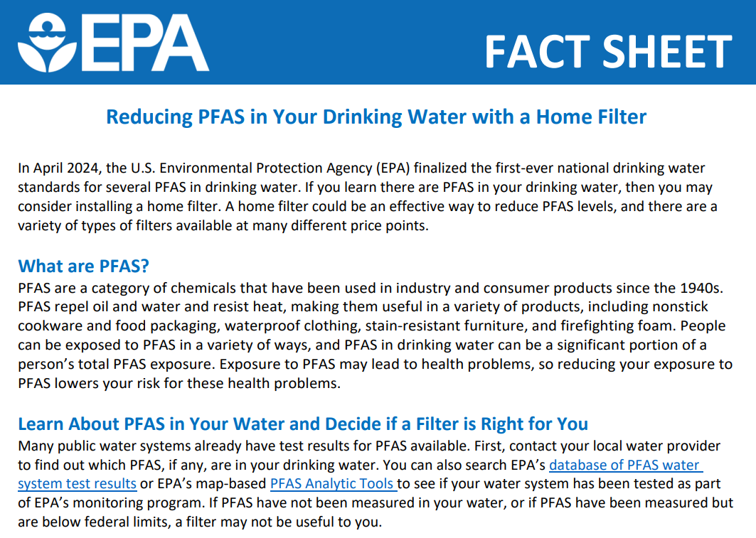
Mitigation: Treatment

Slide 24
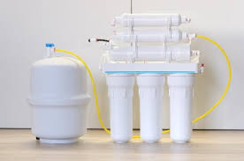
PFAS Treatment: Point-of-Use/Entry
Charcoal (Granular Activated Carbon or GAC): These filters use carbon to trap chemicals as water passes through them.
Reverse Osmosis (RO) Systems: Reverse osmosis is a process that forces water through an extremely thin barrier that separates chemicals from the water.
Ion Exchange Resins: Resins are tiny beads that act like powerful magnets that attract and hold the contaminated materials from passing through the water system.

Slide 25
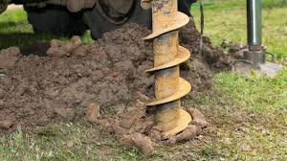
Mitigation: New Source
Pros:
  Potentially reduce PFAS
  Can potentially eliminate other co-contaminants present
  Replace older well that may need it (older infrastructure)
Cons:
  Cost of drilling is high
  May not reduce PFAS
  More compliance requirements for approval

Slide 26
Mitigation: Each System is Unique
Questions to get you started on determining your best options:
  Which of the six PFAS is above the MCL(s)?
  Do you have other contaminants to consider?
  Are there nearby sources to connect to?
  What are your funding options as a private well owner?

Slide 27
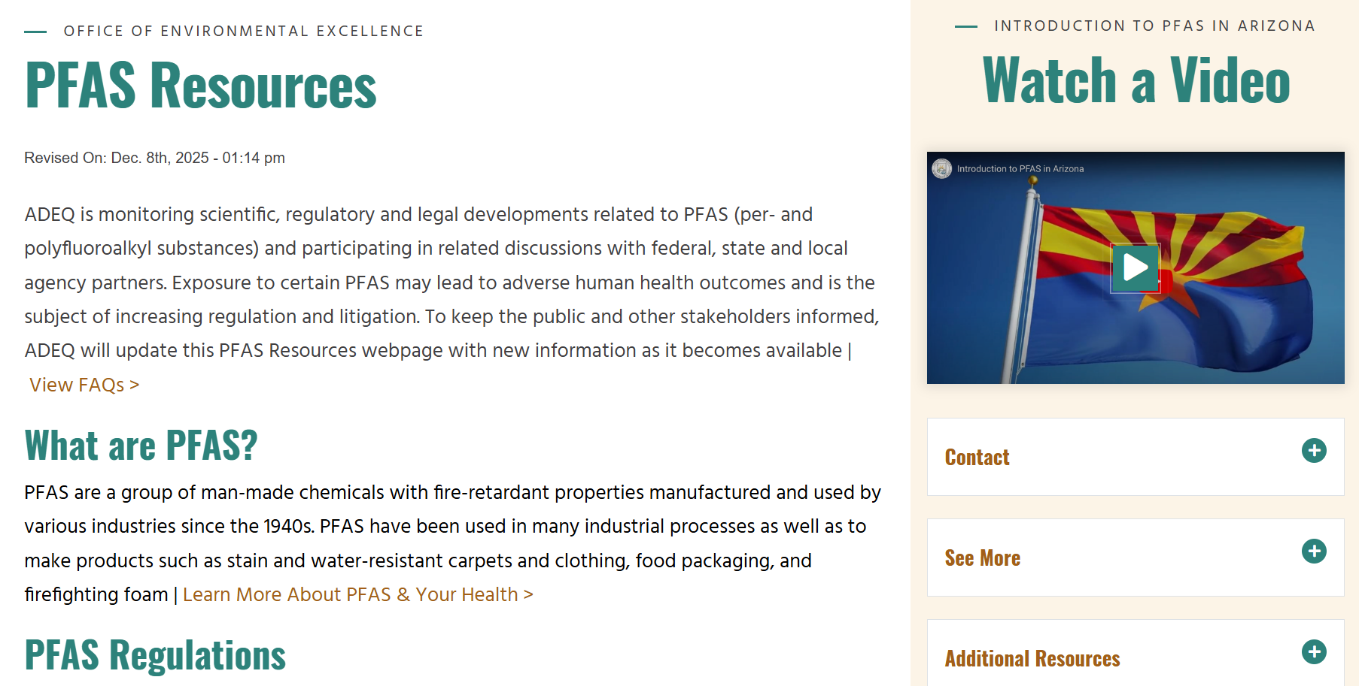
Resources in Arizona

Slide 28
Resources in Arizona
Rural Community Assistance Corporation (RCAC)
ASU & Arizona Water for All
Arizona Department of Environmental Quality (ADEQ)
Environmental Protection Agency (EPA)
  Region 9
United States Department of Agriculture (USDA)
  Section 504 Funding

Slide 29
Stay Updated!
Tips to stay in the loop:
Know your regulatory contacts
Talk to industry experts
Create networks with nearby utilities and local agencies
Join memberships and email lists that send updates on regulations
Ex: EPA, NDEP, AWWA
Utilize sanitary surveys and site visits from primacy agencies

Slide 30
Questions?

Slide 31
Thank You!
Sierra Kubicki
Assistant Field Manager, Arizona
RCAC
725-278-2686
sierra.kubicki@rcac.org

